Slide 1
Project Presentation of CO-OP Project at Industry (Module-2) (22CS421)
On
A Data Science Approach for Analyzing Music Industry Trends Ansh Puri
2210990139
Supervised By
Dr.Simarjit Kaur Virk
Department of Computer Science and Engineering,
Chitkara University, Punjab

Slide 2
Introduction
•In today’s fast-growing world, people have developed higher expectations and more refined tastes in almost every aspect of life, including music. With the rise of the digital era, music has become easily accessible, allowing listeners to enjoy songs anytime and anywhere.It has been made possible through the music streaming platforms such as Spotify,that allows the masses to enjoy music anywhere and anytime[1].
•However, the vast variety of music available today makes it challenging to keep track of different songs and understand the connections between various tunes, styles, and beats.To manage this complexity, algorithms and predictive models have become essential tools in the modern music industry. These technologies can analyze large volumes of music data and provide meaningful insights into what makes a song successful, as well as predict the potential success of new releases[2].This research focuses on understanding the relationship between a song’s audio features and its popularity.
•The dataset used for this study is taken from Spotify (via Kaggle) and includes attributes such as key, tempo, and other musical characteristics[3]. In this context, a song’s popularity is measured based on its number of streams. By analyzing these audio features alongside popularity, the study aims to identify the key factors that contribute to a song’s success.
•To achieve this, various machine learning algorithms and statistical techniques will be applied to analyze large datasets related to music[4]. By identifying the most influential features, this research seeks to provide valuable insights into trends within the music industry.
It will also explore whether the success of past songs can help predict the performance of future releases and determine which factors have the greatest impact on a song’s popularity.Ultimately, this project aims to enhance our understanding of how the music industry is evolving and how data-driven approaches can shape its future.

Slide 3
Literatrue Review
In recent years, the music industry has seen a major shift with the growth of digital streaming platforms. This has led researchers to explore how data science can be used to better understand music trends and predict the success of songs[2],[3]. Several studies have focused on analyzing large datasets from platforms like Spotify, where information about songs and listener behavior is easily available.
Many researchers have studied the relationship between a song’s audio features—such as tempo, energy, danceability, and genre—and its popularity[4],[5]. Their findings suggest that certain combinations of these features can influence how well a song performs. For example, songs with higher energy and danceability are often more popular among listeners. However, these patterns are not always consistent, as music preferences can vary widely between audiences.
To analyze such data, different machine learning techniques have been used in previous studies. Models like linear regression, decision trees, and random forests are commonly applied to identify patterns and make predictions[5]. In some cases, neural networks have also been used to capture more complex relationships within the data[6]. These methods have helped researchers gain deeper insights into what makes a song successful.

Slide 4
Methodology
The methodology of this project follows a structured approach to analyze and predict song popularity using machine learning techniques. The overall process consists of data collection, preprocessing, feature analysis, model development, and evaluation.
•Data Collection
Firstly, the dataset is collected from a publicly available Spotify dataset on Kaggle. The dataset contains approximately 3000 songs along with various audio features such as tempo, energy, danceability, loudness, and popularity scores.
•Data Preprocessing
In the preprocessing stage, the dataset is cleaned to ensure accuracy and consistency. Missing values are handled, and unnecessary or irrelevant features are removed. Numerical features are normalized to bring them to a similar scale, which helps improve the performance of machine learning models.
•Feature Analysis
After preprocessing, feature analysis is performed to understand the relationship between different audio features and song popularity. Visualization techniques such as scatter plots and correlation heatmaps are used to identify patterns and dependencies within the data.
•Predictive Modelling
Next, multiple machine learning models are applied, including Linear Regression, Decision Tree, Random Forest, and Neural Networks. The dataset is divided into training and testing sets in an 80:20 ratio to evaluate the performance of these models. Linear Regression is used as a baseline model, while Decision Tree and Random Forest are used to capture non-linear relationships. Neural Networks are applied to model more complex patterns in the data.
Finally, the performance of each model is evaluated using metrics such as Mean Squared Error (MSE) and R-squared (R²). These metrics help in comparing the accuracy and effectiveness of the models in predicting song popularity.

Slide 5
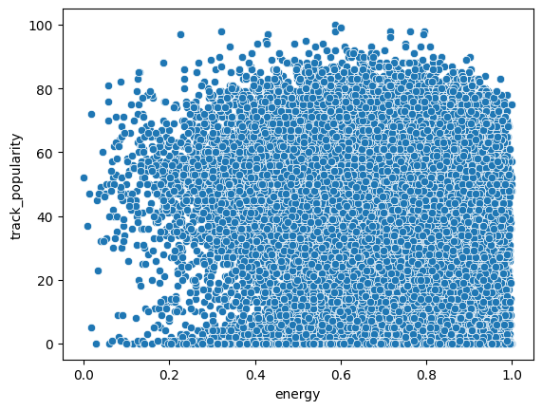
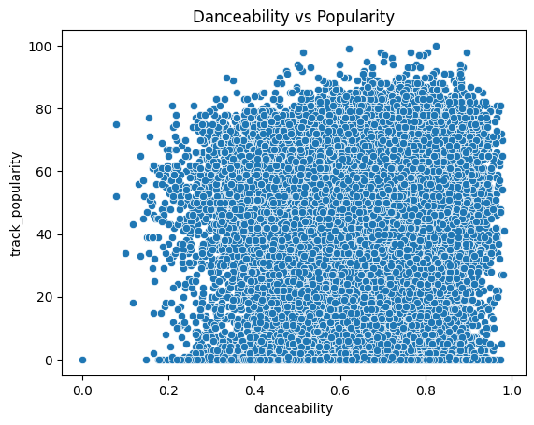
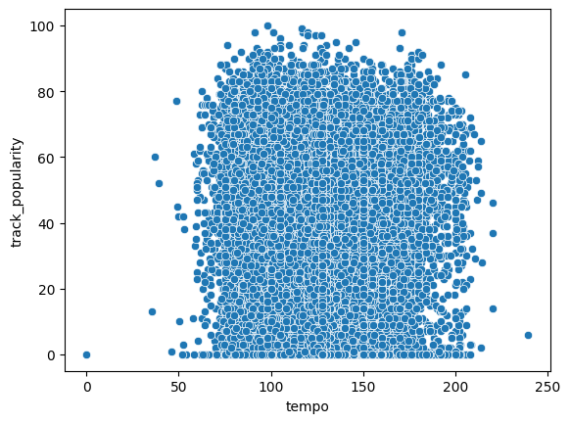
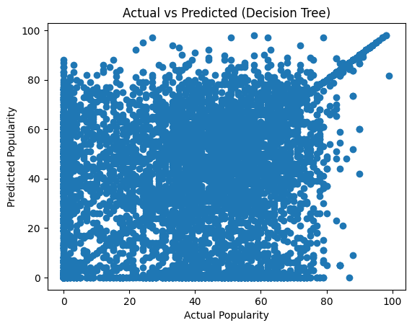
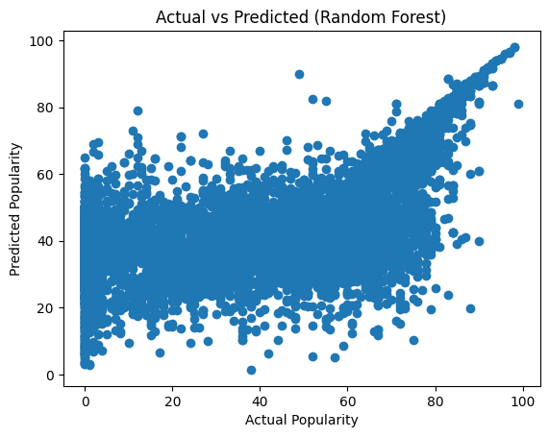
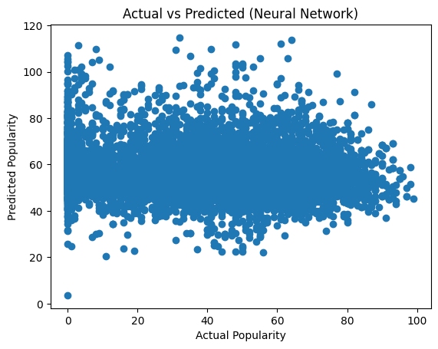
Results
The following results were being achieved:

Slide 6
Key Features
• Use of a real-world Spotify dataset containing approximately 3000 songs.
• Analysis of multiple audio features such as tempo, energy, danceability, and loudness.
• Application of different machine learning models including Linear Regression, Decision Tree, Random Forest, and Neural Networks.
• Comparison of model performance using evaluation metrics such as Mean Squared Error (MSE) and R-squared (R²).
• Identification of important patterns and relationships between audio features and song popularity.
• Use of data visualization techniques such as scatter plots and correlation heatmaps.
• Evaluation of model effectiveness in predicting song popularity.
• Highlighting the limitations of predicting popularity using only audio features.

Slide 7
Objectives
• To analyze the relationship between audio features and song popularity.
• To use a real-world Spotify dataset for data-driven analysis.
• To apply machine learning models for predicting song popularity.
• To compare the performance of different models such as Linear Regression, Decision Tree, Random Forest, and Neural Networks.
• To evaluate model performance using metrics such as Mean Squared Error (MSE) and R-squared (R²).
• To identify the most effective model for predicting song popularity.
• To understand the limitations of predicting popularity using only audio features.

Slide 8
Tools and technologies
• Python: Used as the primary programming language for data analysis and model implementation.
• NumPy: Used for numerical computations and handling array-based data efficiently.
• Pandas: Used for data manipulation, cleaning, and preprocessing of the dataset.
• Matplotlib and Seaborn: Used for data visualization, including graphs and correlation analysis.
• Scikit-learn: Used for implementing machine learning models such as Linear Regression, Decision Tree, and Random Forest.
•TensorFlow/Keras: Used for building and training the Neural Network model.
•Kaggle: Used as the source of the Spotify dataset for analysis.

Slide 9
References
[1] Spotify, "Spotify Official Website." [Online]. Available: https://www.spotify.com
[2] Kaggle, "Spotify Dataset." [Online]. Available: https://www.kaggle.com
[3] F. Pedregosa et al., "Scikit-learn: Machine Learning in Python," Journal of Machine Learning Research, 2011.
[4] C. R. Harris et al., "Array programming with NumPy," Nature, 2020.
[5] W. McKinney, "Data Structures for Statistical Computing in Python," Proc. SciPy, 2010.
[6] S. Bhavanasi et al., "Spotify Data Analysis and Song Popularity Prediction," 2022.
[7] J. Brownlee, "Machine Learning Mastery with Python," Machine Learning Mastery, 2016.
[8] L. Breiman, "Random Forests," Machine Learning, vol. 45, no. 1, pp. 5–32, 2001.
[9] T. Hastie, R. Tibshirani, and J. Friedman, "The Elements of Statistical Learning," Springer, 2009.
[10] D. P. Kingma and J. Ba, "Adam: A Method for Stochastic Optimization," 2015.
[11] I. Goodfellow, Y. Bengio, and A. Courville, "Deep Learning," MIT Press, 2016.
[12] A. Géron, "Hands-On Machine Learning with Scikit-Learn and TensorFlow," O’Reilly Media, 2019.
[13] K. Murphy, "Machine Learning: A Probabilistic Perspective," MIT Press, 2012.
[14] J. Han, M. Kamber, and J. Pei, "Data Mining: Concepts and Techniques," Elsevier, 2011.
[15] B. McFee et al., "librosa: Audio and Music Signal Analysis in Python," Proc. SciPy, 2015.
[16] M. Müller, "Fundamentals of Music Processing," Springer, 2015.
[17] Y. Hu, X. Chen, and D. Yang, "Music Recommendation Based on Audio Features and User Preferences," IEEE Access, 2018.
[18] R. Knees and M. Schedl, "Music Similarity and Retrieval: An Introduction," Springer, 2016.
[19] G. Tzanetakis and P. Cook, "Musical Genre Classification of Audio Signals," IEEE Transactions on Speech and Audio Processing, 2002.
[20]S. Dieleman and B. Schrauwen, "End-to-End Learning for Music Audio," IEEE ICASSP, 2014.

Slide 10
Thank You

